Slide 1
Business Insights
Sales Funnel Analysis

Slide 2
Introduction
Brief Insight Analysis of Sales Funnel
Brief Insight Analysis from Number of Leads Onboarded in Different Cities
Brief Insight Analysis from Number of active Leads from March-April 2023
Conclusion

Slide 3
INTRODUCTION:
This sales funnel analysis offers valuable insights into a hostel booking platform's performance.
It examines lead generation, conversion rates, regional demand variations, and highlights seasonal trends.
These findings emphasize the importance of strategic lead management and targeted marketing efforts.

Slide 4
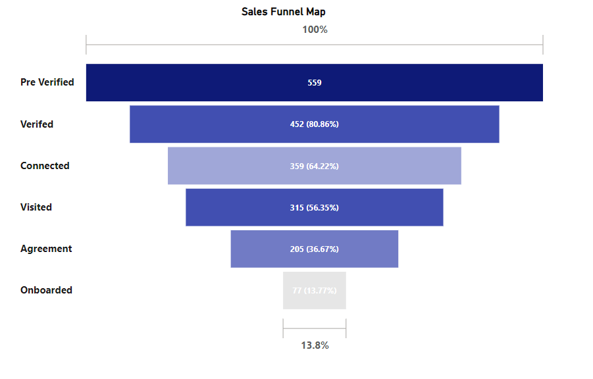

Slide 5
"Pre-Verification” stage, which had the highest lead count at 559, is a crucial initial step in the process.
The "Verified" stage achieved a strong conversion rate of 80.86%, signifying the effectiveness of the verification process in establishing trust.
The "Connected" stage displayed a slightly lower conversion rate of 79.42%, indicating room for improvement at this stage.
The "Visited" stage boasted a high conversion rate of 87.74%, reflecting positive responses to property visits.
However, the "Agreement" stage had a lower conversion rate of 65.08%, suggesting potential challenges in the negotiation and agreement phase.
Lastly, the "Onboarded" stage recorded the lowest conversion rate at 37.56%, indicating room for optimization in the onboarding process.

Slide 6
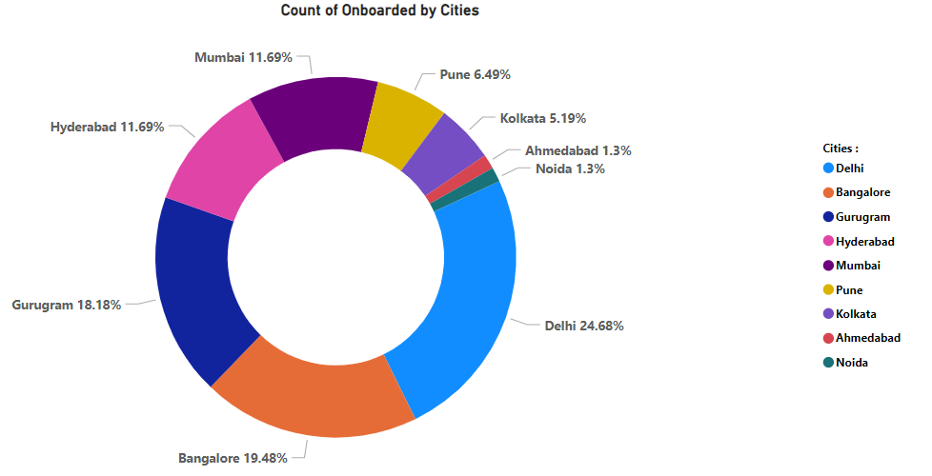
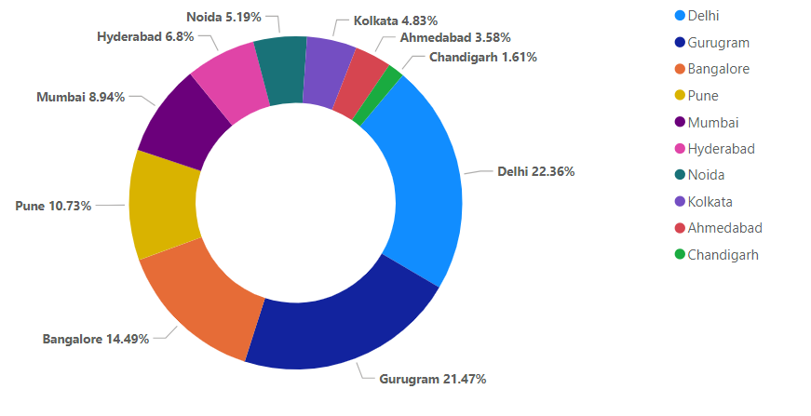

Slide 7
Brief Insight Analysis from No of Leads Onboarded in Different Cities
Delhi has the highest number of onboarded students, indicating a strong demand for hostels in the city.
Bangalore and Gurugram also show significant conversion rates, suggesting a thriving student population in those cities.
Chandigarh has no onboarded students, indicating a potential untapped market or lower demand for hostels.
Other cities, such as Hyderabad, Kolkata, Mumbai, Pune, and Noida, have moderate conversion rates, indicating a decent market for hostels.
Ahmedabad and Noida have the lowest conversion rates, suggesting potential areas for improvement in attracting and converting leads.
Overall, the data highlights the regional variations in hostel demand and the need for targeted marketing strategies in each city.

Slide 8
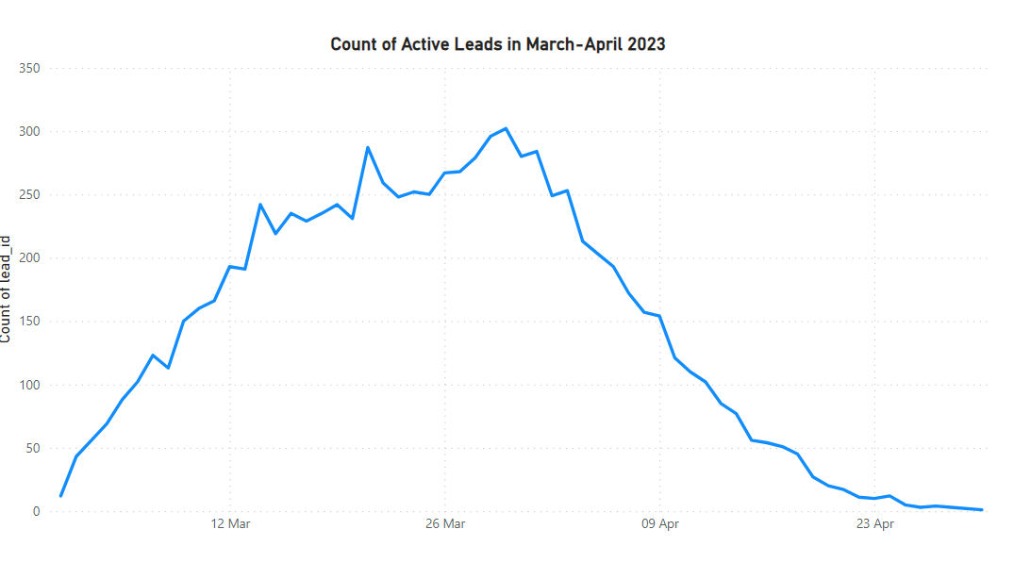

Slide 9
Brief Insight Analysis from Number of Active Leads from March-April 2023
The graph shows a clear increasing trend in the number of leads from March 1st to March 21st, reaching a peak at 287 leads.
After that, the lead count starts to decline until April 30th. A seasonal pattern is also visible in the graph, suggesting the influence of certain factors on lead generation.
By comparing the data with other metrics, such as conversion rates or sales, it becomes possible to measure the effectiveness of lead generation efforts.
The graph can also help identify any impact of marketing campaigns and initiatives on lead generation.
Furthermore, the declining trend after March 21st indicates the need for lead nurturing strategies.
Finally, any unexpected variations in lead counts can be identified and further investigated.

Slide 10
Conclusion
The pre-verification stage plays a vital role in lead generation, as it builds trust and authenticity, resulting in high conversion rates. To optimize lead conversion, there is room for improvement in the connection and agreement stages.
Regional variations are evident, with Delhi, Bangalore, and Gurugram demonstrating robust conversion rates, while Chandigarh represents untapped potential.
Analyzing lead trends and seasonal patterns underscores the importance of strategic lead management and targeted marketing efforts.
Further analysis is required to identify and address any data anomalies and potential issues

